Slide 1
Hospital Management System
Subject name: java Programming
Team members names: Admission no.
Abhay fulara (Team leader) (24scse1180211)
Ayush Deol (24scse1180210)
Aryan Sachan (24SCSE1410126)

Slide 2
OBJECTIVE
To develop a Hospital Management System using Java, OOP concepts, GUI, JDBC, and MySQL to efficiently manage hospital operations.
Key Features
Patient Information Management
Doctor Management
Appointment Scheduling
Bed Availability & Allotment
View Records (Patients, Doctors, Appointments)
MySQL Database Storage

Slide 3
TOOLS AND TECHNOLOGIES USED
Java (OOP Concepts):
Core language used to implement the project using Object-Oriented Programming principles like classes, objects, Inheritance, encapsulation, and abstraction.
VS Code (Visual Studio Code) :
Used as the primary development environment with Java extensions for code writing, debugging, and testing.
MySQL Database
Swing GUI
JDBC (Java Database Connectivity)
JDK (Java Development Kit)

Slide 4

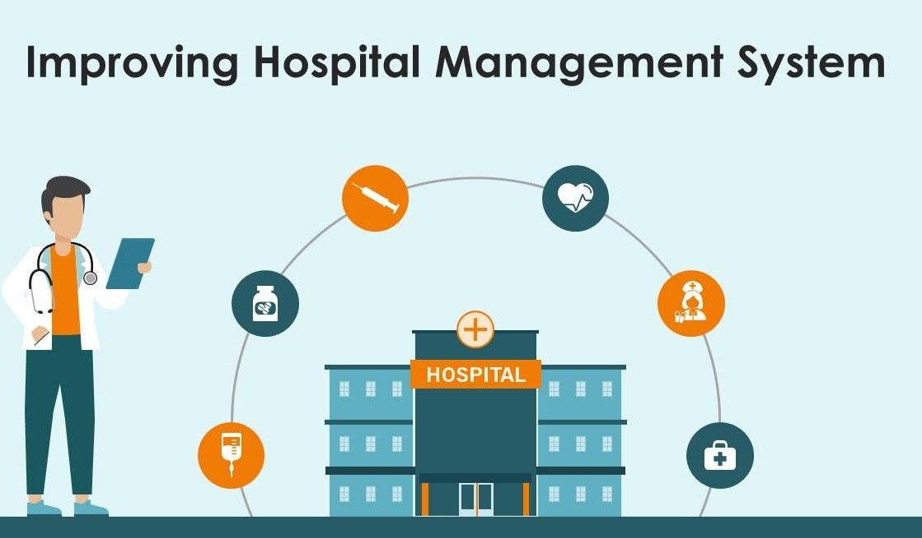
APPROACH & EXPECTED RESULTS
Approach
Used Java OOP for structured design
Implemented JDBC + MySQL for persistent storage
Used Swing GUI to make user-friendly interface
Added multithreading
Followed clean folder structure
Expected Results
Working hospital management application
Able to manage patients, doctors, appointments, beds
Demonstrates Java, JDBC, OOP & GUI skills

Slide 5
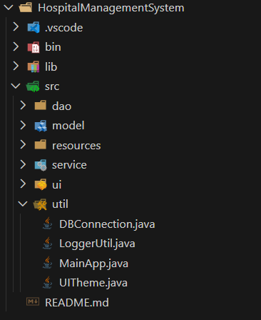
FILE STRUCTURE OF PROJECT
The project uses a structured folder system:
model – stores all data classes
dao – handles database CRUD operations
util – database connection and multithreading
ui – Java Swing interface panel classes
Main class – loads the entire GUI

Slide 6
GUI (Java Swing)
The Hospital Management System is a desktop-based application developed using Java Swing for the graphical user interface and MySQL as the backend database.
The application helps hospitals manage patients, doctors, beds, and appointments efficiently using a centralized system connected via JDBC.
Main GUI Structure
The application is built using a main JFrame containing:
Menu Bar / Navigation Tabs
  Dashboard
  Patients
  Doctors
  Beds
  Appointments
CardLayout
  Each module opens inside the same window
  Ensures smooth navigation without opening new windows

Slide 7
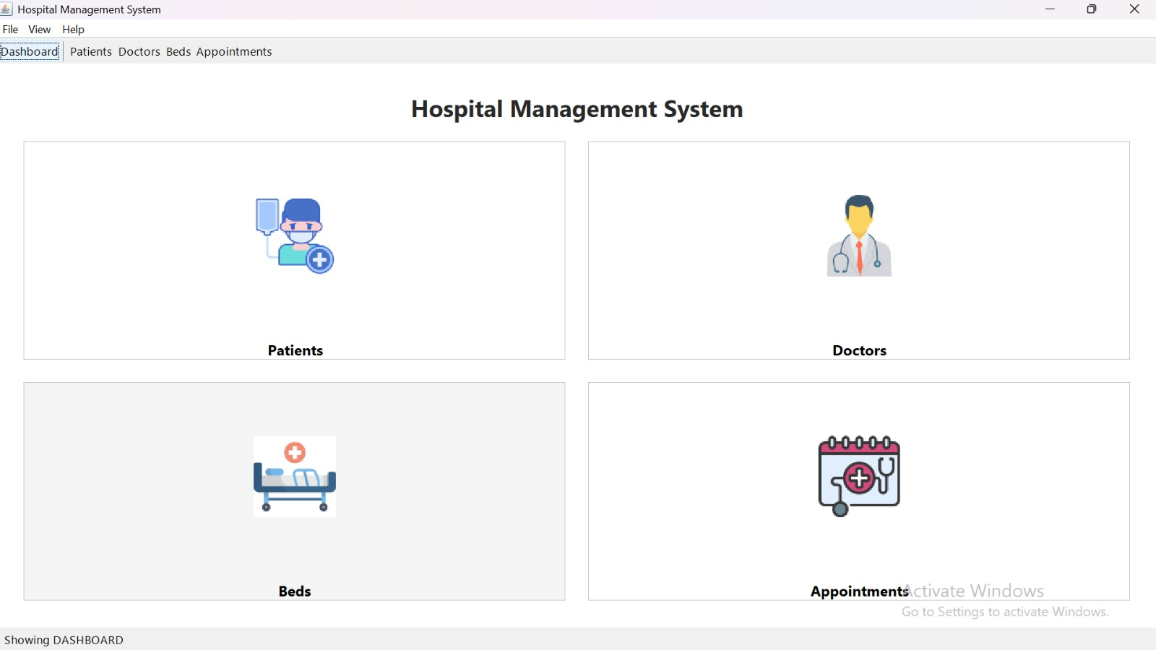
1. Dashboard
Purpose:
Provides a central interface to access all major modules of the hospital management system. Application title, icons/buttons for Patients, Doctors, Beds, and Appointments, quick navigation to different modules

Slide 8
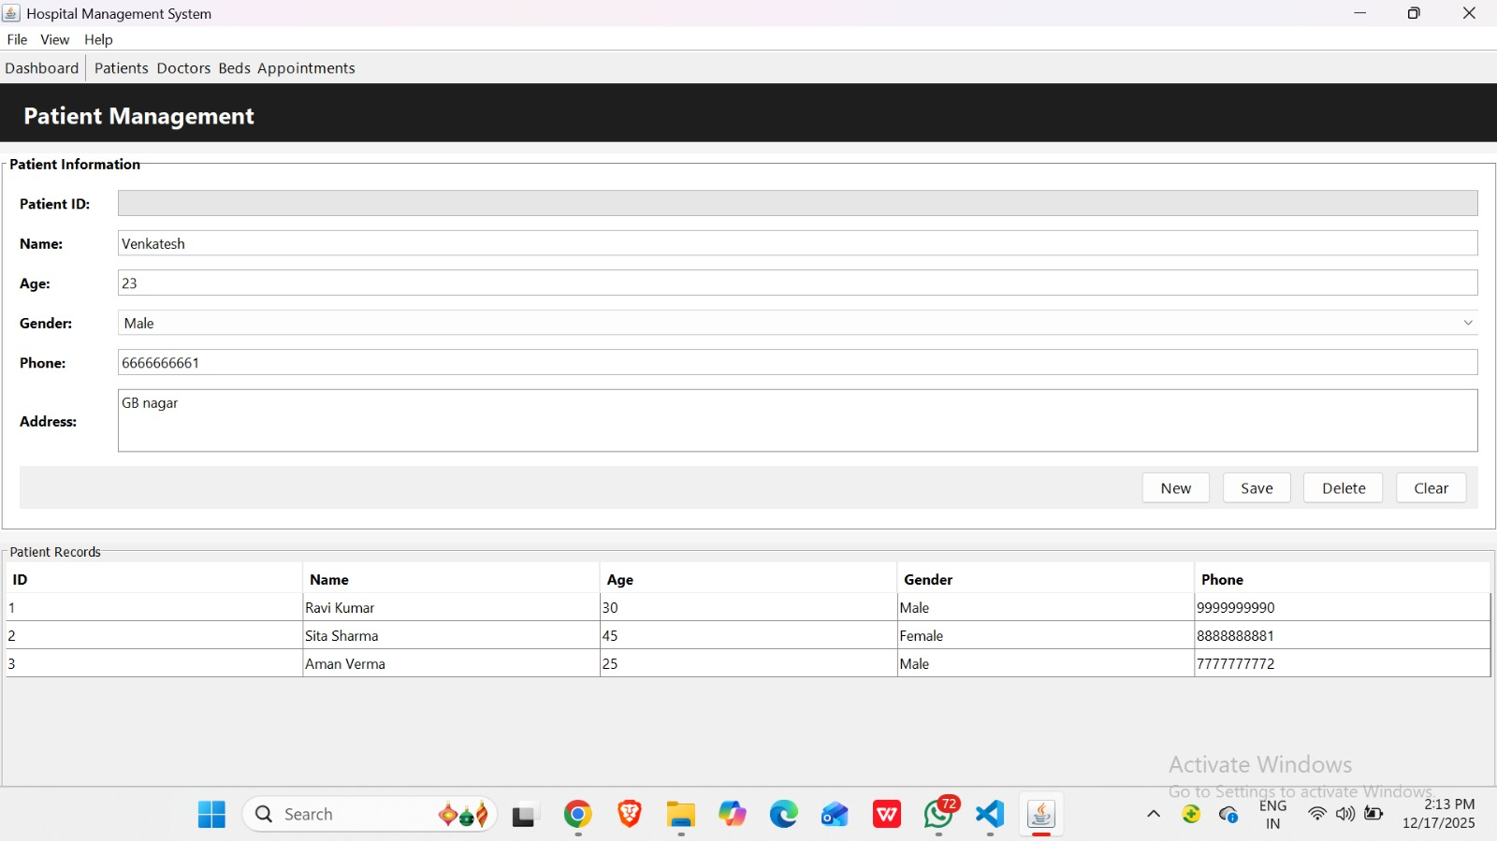
2. Patient Management
Purpose:
The Patient Management Module is used to manage and maintain all patient-related information in the hospital system. Patient ID (auto-generated), Name, Age, Phone number, Gender, Address and a table displaying all patient records fetched from the database

Slide 9
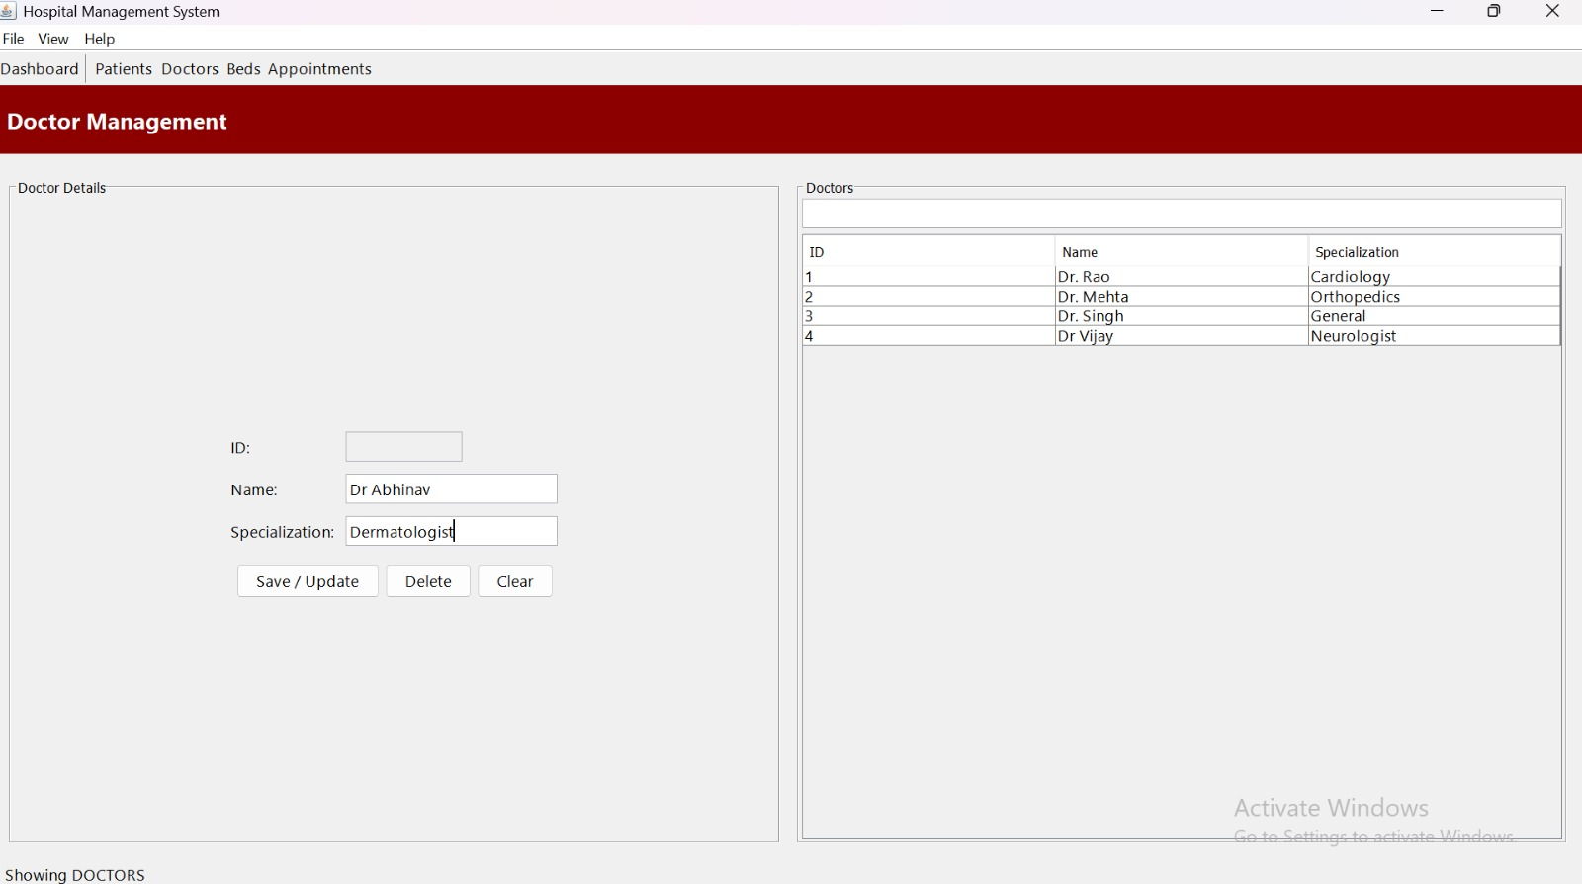
3. Doctor Management
Purpose:
Handles doctor details and specialization information.
Doctor ID, Doctor name, Specialization, Table showing list of doctors

Slide 10
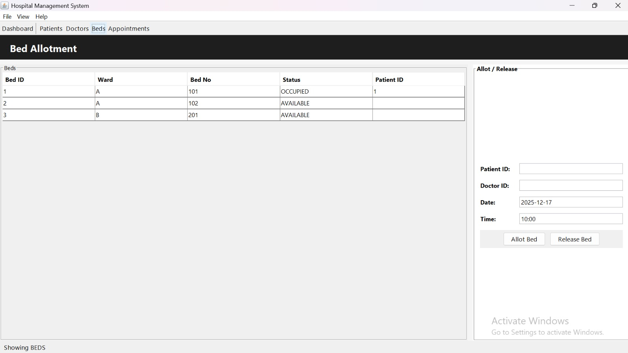
4. Bed Management (Bed Allotment)
Purpose:
Manages hospital bed availability and patient bed allotment.
Bed ID, Ward, Bed number, Bed status (AVAILABLE / OCCUPIED), Patient ID (if allotted), Fields for Patient ID, Doctor ID, Date, and Time, Buttons for Allot Bed and Release Bed

Slide 11
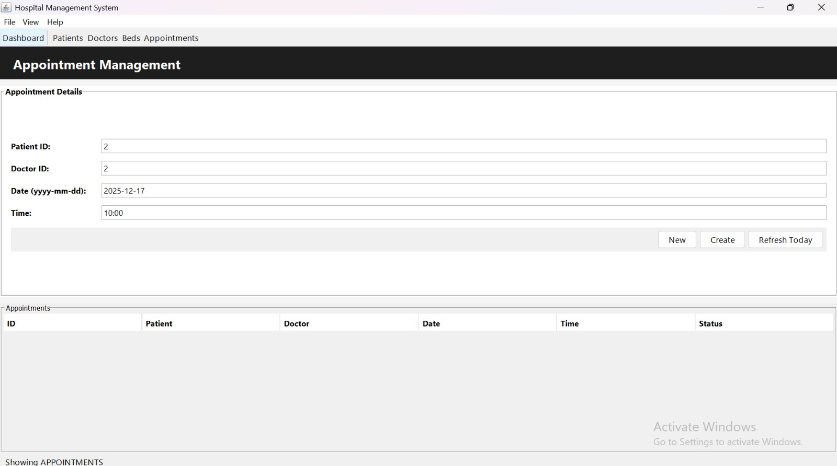
5. Appointments Module
Purpose:
Schedules and manages appointments between patients and doctors.
Patient details, Doctor details, Appointment date and time, Table showing appointment records

Slide 12
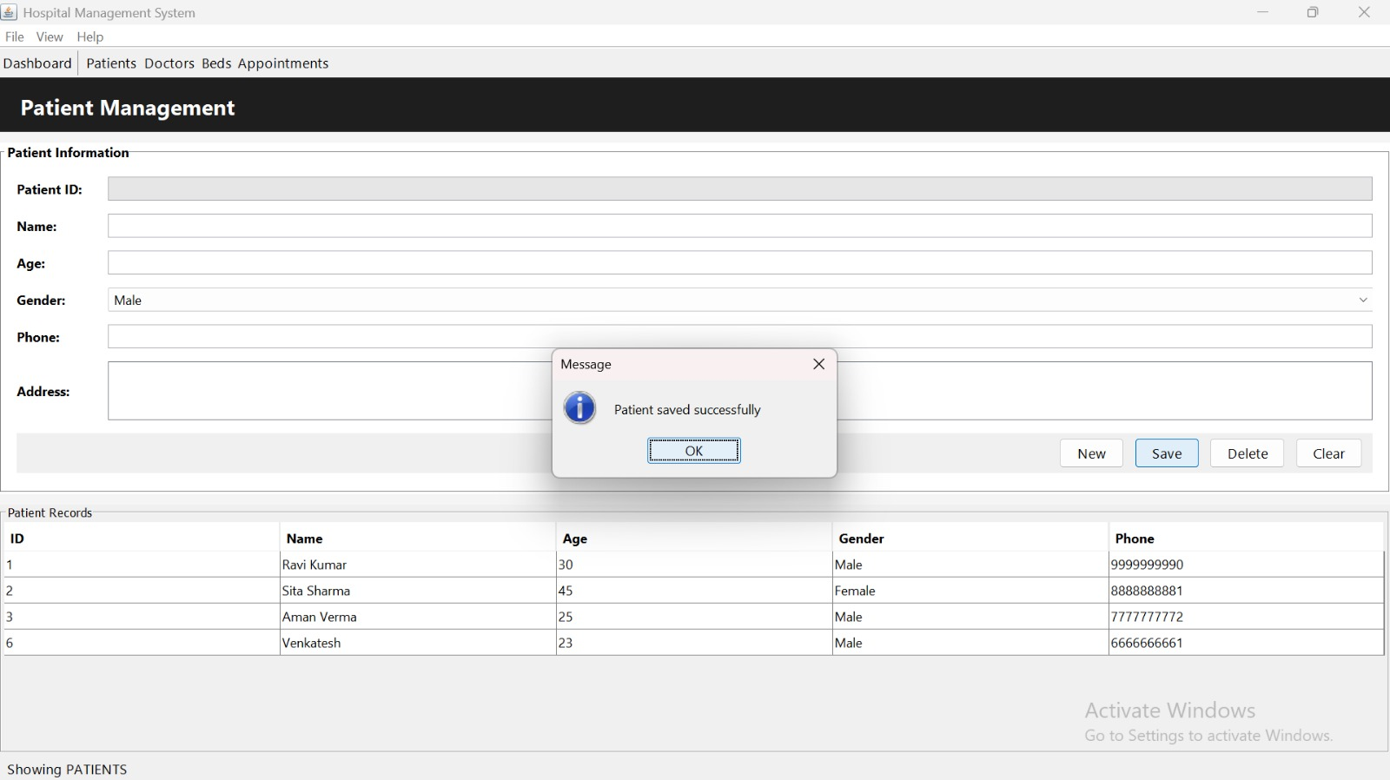
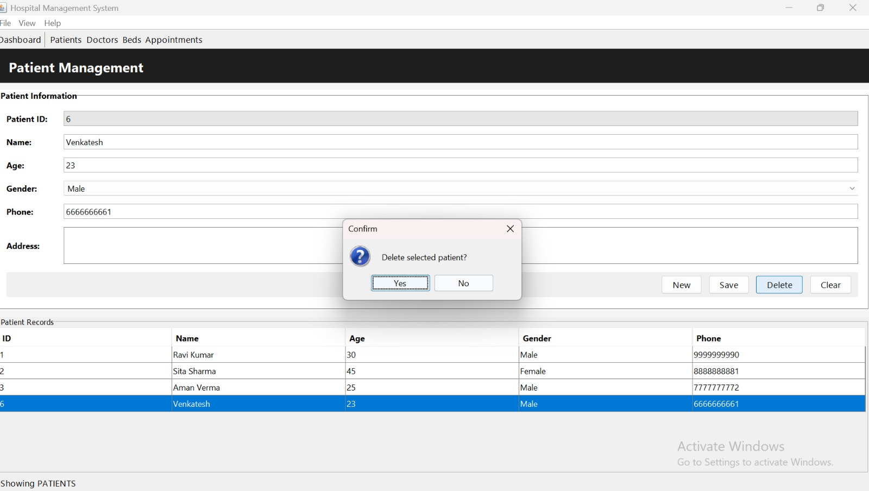
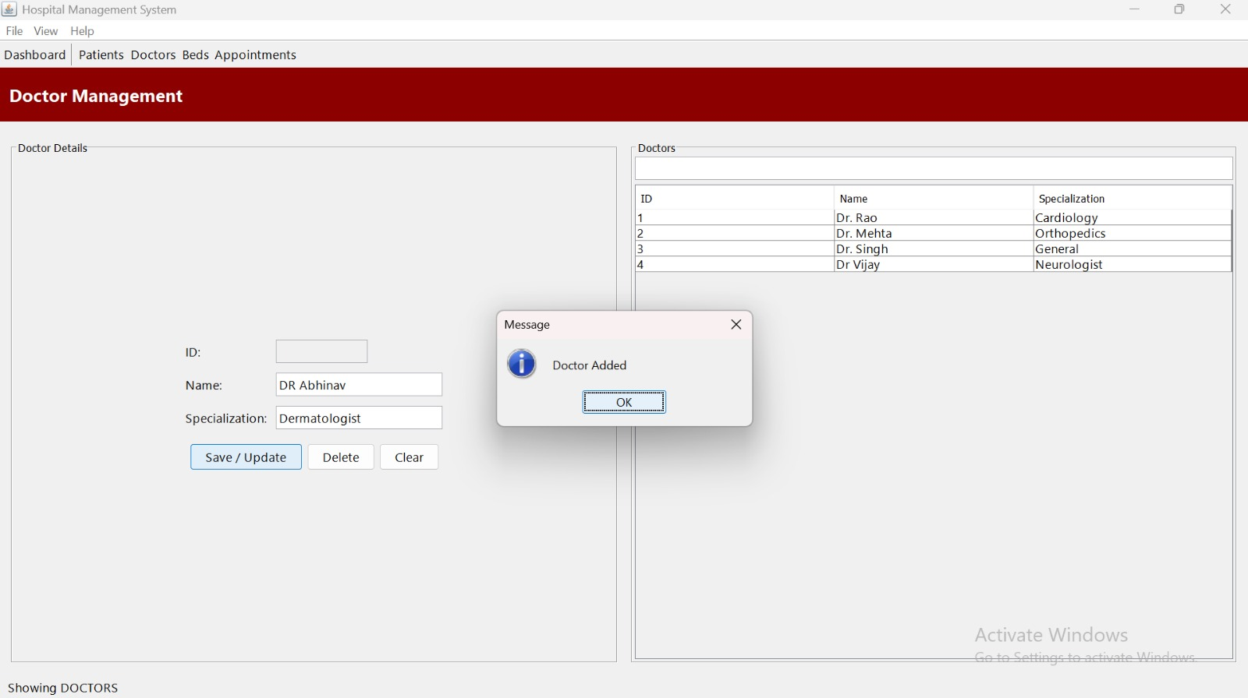
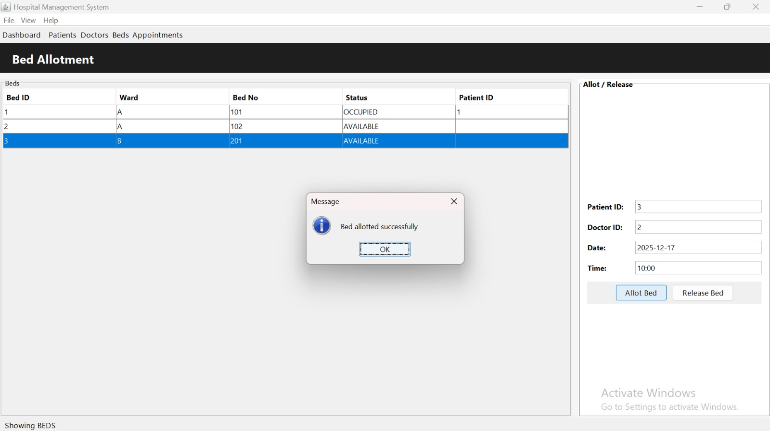
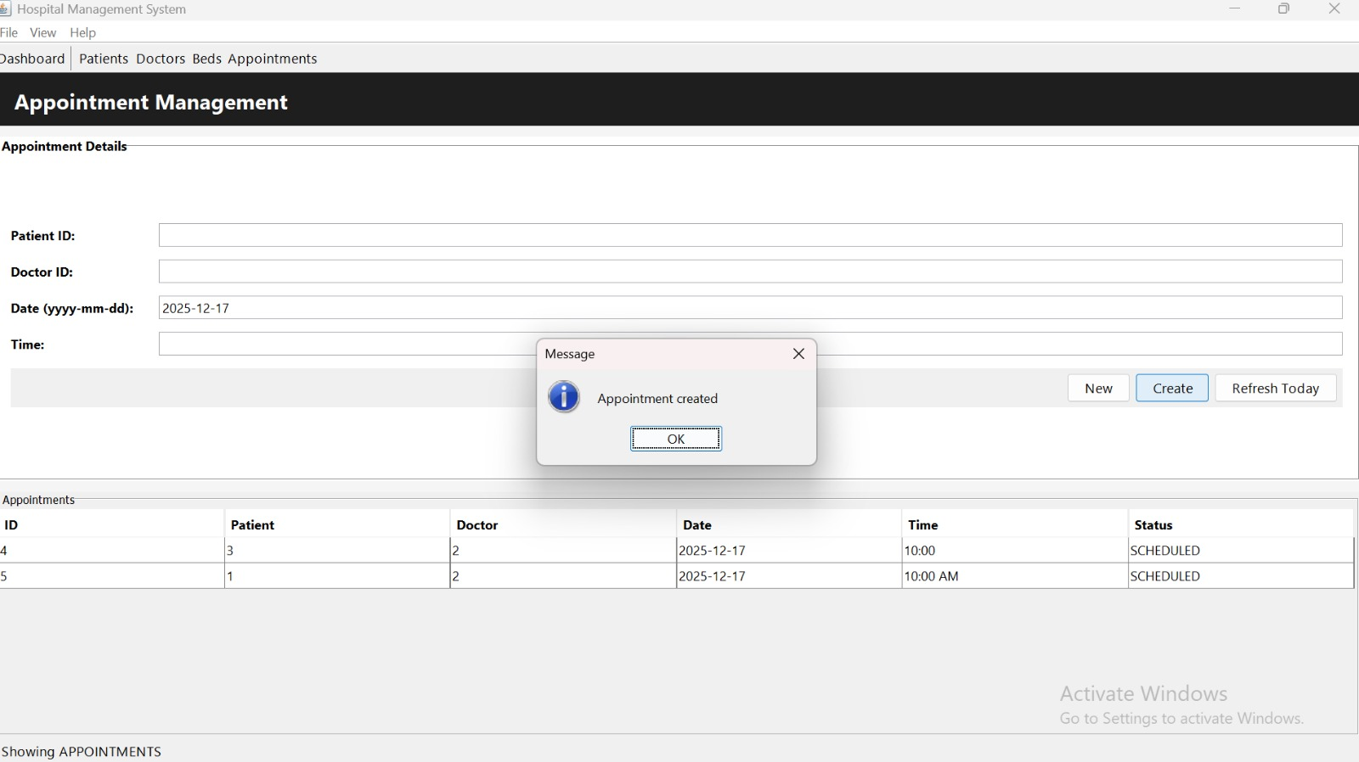

Slide 13
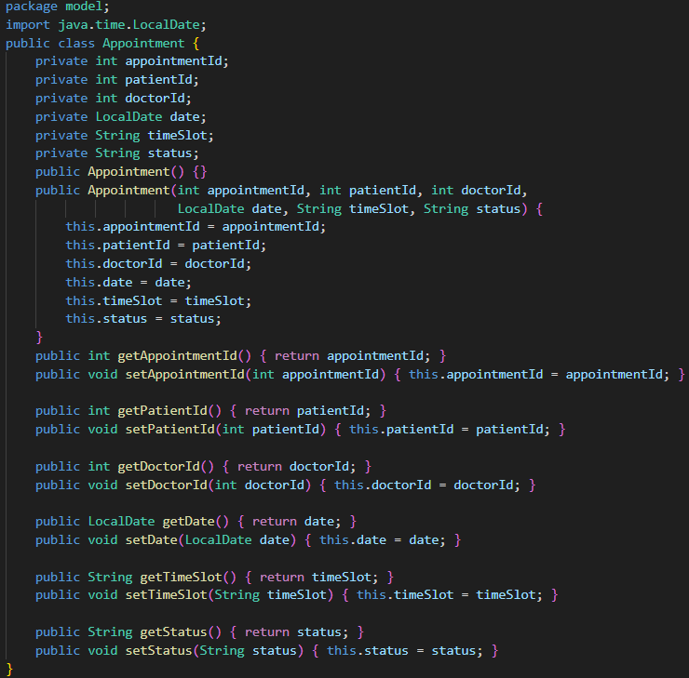
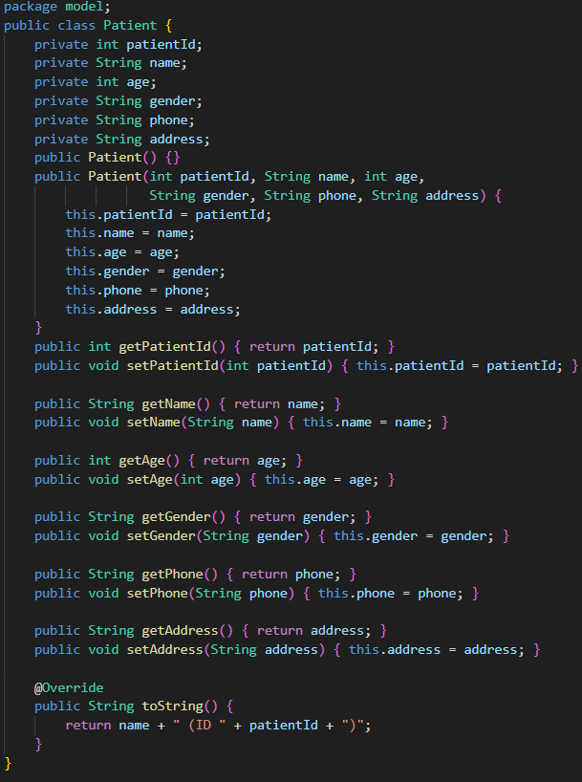
IMPORTANT CLASSES WITH CODES:-
1. Appointment class
Purpose:
Represents an appointment scheduled between a patient and doctor, along with a bed allotment.
2. Patient Class
Purpose:
Represents a hospital patient and stores their information like name, age, gender, address and phone number.

Slide 14
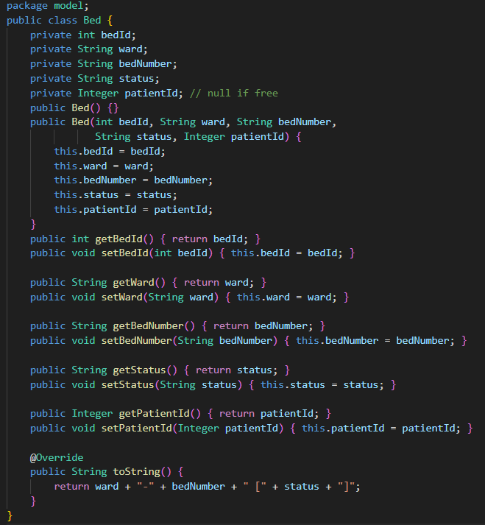
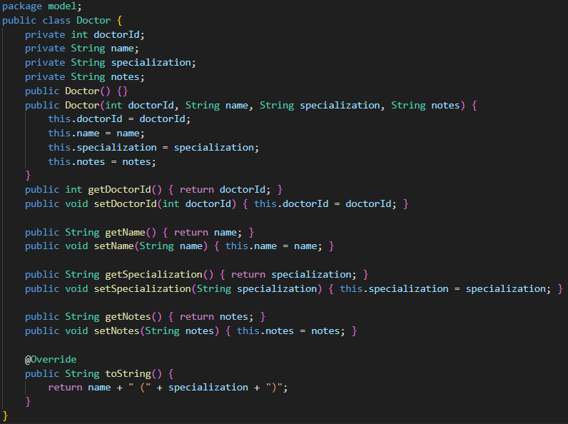
3. Bed Class
Purpose:
To represent hospital beds and track their availability.
4. Doctor Class
Purpose:
Represents a doctor, storing details unique to doctors.

Slide 15
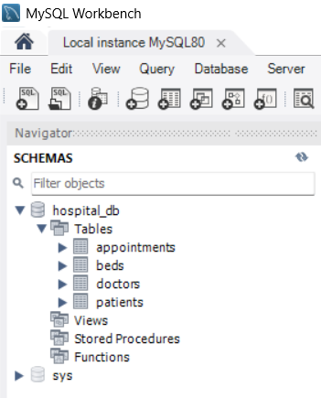
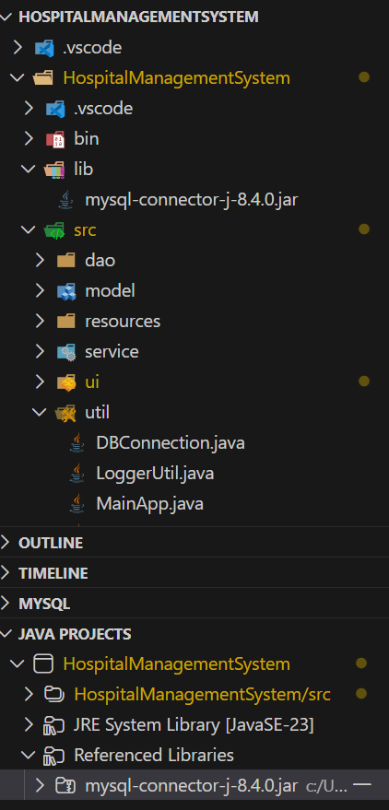
DATABASE AND JDBC
Using Connector J 8.4.0 and its jar file
Using MYSQL 8.0.44

Slide 16
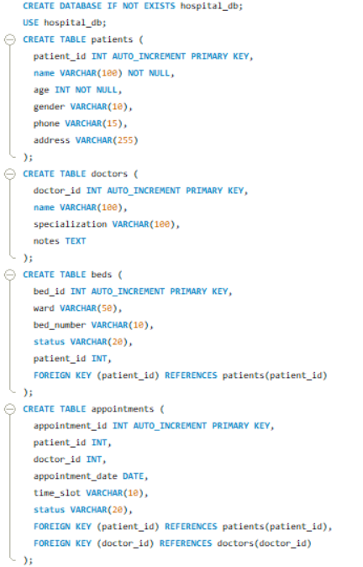
Database Schema (SQL)
The Hospital Management System uses a MySQL database named hospital_db that stores all information related to patients, doctors, beds, and appointments. Four main tables are created in the schema:
doctors – stores doctor names and specialities.
patients – stores patient details such as name, age, and gender.
beds – holds hospital bed numbers and their availability status.
appointments – links patient, doctor, and bed records together using foreign keys, along with appointment date and time.
This structured schema ensures proper data management, prevents invalid entries, and supports all core system operations like booking appointments and allocating beds.

Slide 17
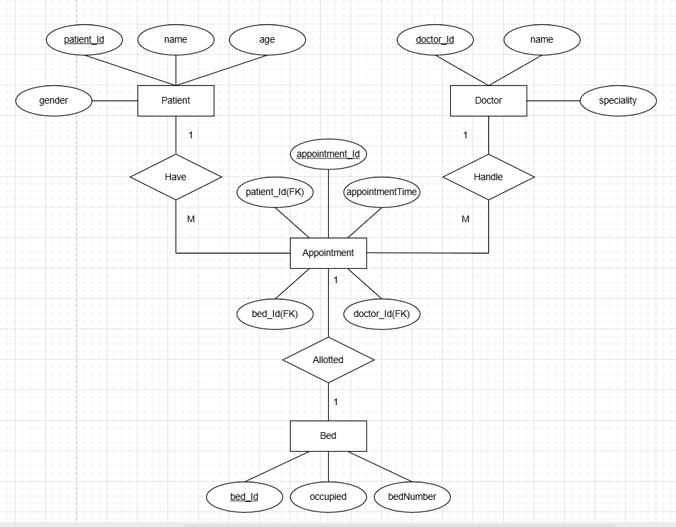
ER DIAGRAM:
Entities:
Patient, Doctor, Appointment, Bed.
Relationships:
Patient (1) — (M) Appointment
One patient can have many appointments.
Doctor (1) — (M) Appointment
One doctor can handle many appointments.
Bed (1) — (1) Appointment (at a time)
A bed can be allotted to only one appointment at a time.
Appointment acts as the bridge entity linking: Patient, Doctor and Bed.

Slide 18
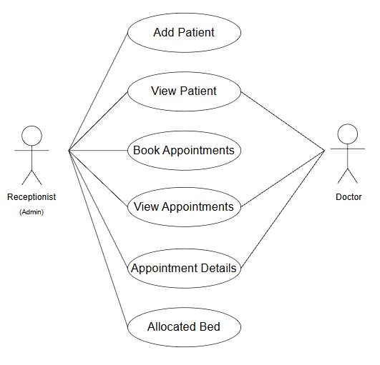
USE CASE DIAGRAM
A use case diagram is a specific type of UML diagram used to model the interactions between user and a system

Slide 19
BENEFITS & LIMITATIONS
Benefits
Real hospital operations simulated
GUI-based → user friendly
Database storage → data does not get lost
Supports CRUD operations
Uses OOP concepts
Includes multithreading
Transaction support → avoids double booking
Limitations
Basic UI (Swing)
No login system
Limited validation
Not designed for large-scale hospital use
No billing system (can be added later)

Slide 20
FUTURE IMPROVEMENTS
Add Login and Authentication
Add Billing & Payment System
Add Pharmacy and Inventory Module
Add PDF Report Generation
Add Doctor Schedule & Availability
Add Nurse / Staff Management
Add Advanced Search & Filters

